Slide 1
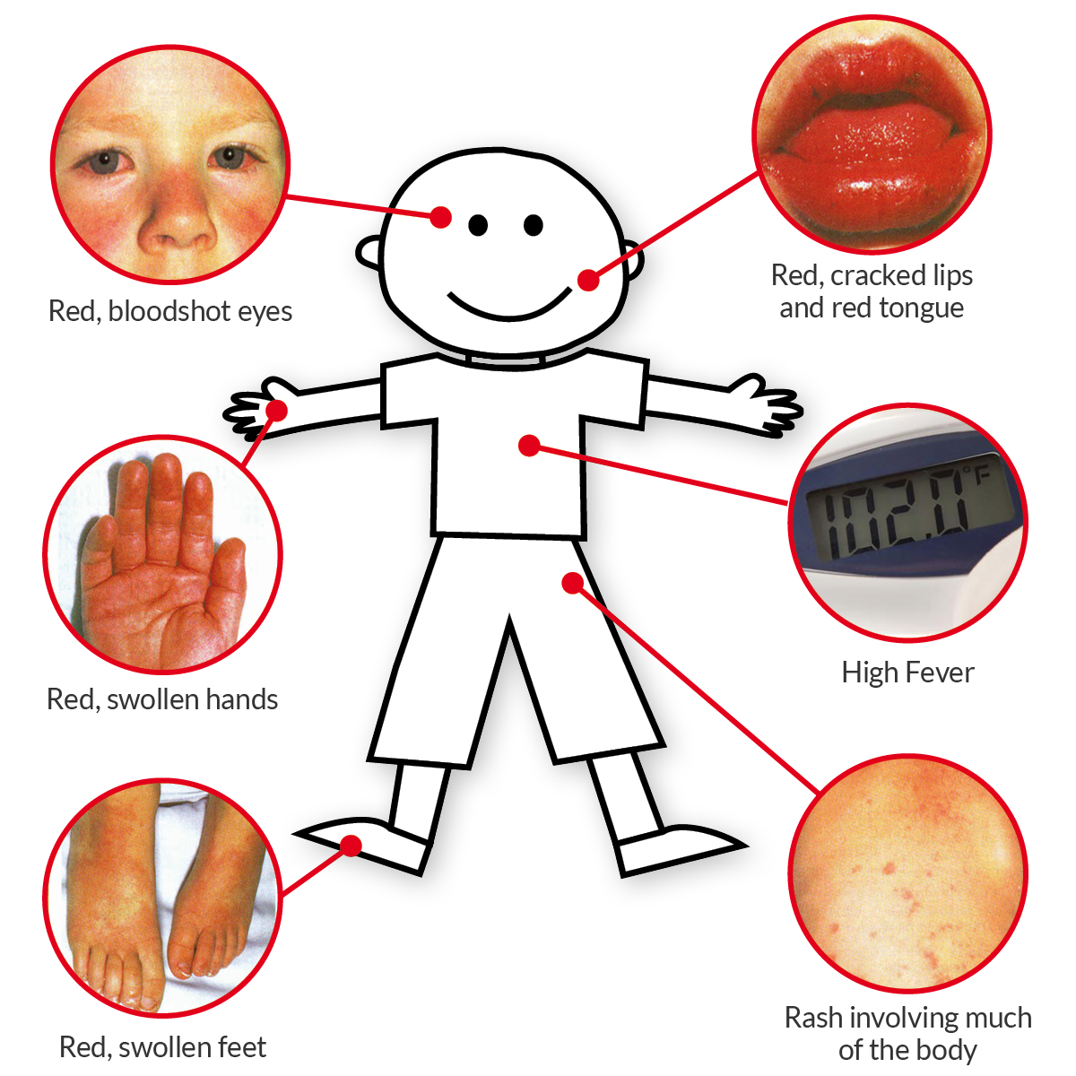
Investigation of clinical and epidemiological characteristics of Kawasaki patients
Ibrahim AL Harach¹, Yılmaz Yozgat ², Kahraman Yakut², N.Tekin ³, E.Tekin ³, Ö.F.karagöz⁴ , A.yabaci⁵.
Bezmialem Vakıf University, Faculty of Medicine, Istanbul, Turkey
Introduction:
Kawasaki disease is a systemic vasculitis of unknown etiology which is more common in children aged 6 months to 5 years .Fever, bilateral non-exudative conjunctivitis, skin and mucous membrane involvement and cervical lymphadenopathy is the most common symptoms.
The absence of a specific laboratory test or clinical findings for Kawasaki disease causes difficulties in diagnosis. It involve many medium-sized arteries, predominantly the coronary artery, and that leads to significant morbidity and mortality.
Coronary artery involvement is observed in 20-30% of the cases in whom IVIG cannot be administered in the acute period. This condition causes myocardial ischemia, rarely infarction, aneurysm rupture, and even death. With the use of high-dose IVIG and ASA, the risk of coronary artery involvement has decreased to 2-3%.
In this study, we retrospectively investigated the demographic characteristics, clinical and laboratory findings, treatment and follow-up results of patients who were followed up and treated with Kawasaki diagnosis in the last 10 years in Bezmialem hospital.
Materials and Methods:
A retrospective study, we took 36 patients who were diagnosed with Kawasaki disease between February 2009 -February 2020 in Bezmialem hospital. We studied the patients in two groups as Kawasaki disease and incomplete Kawasaki disease.
Demographic characteristics, clinical findings, laboratory data and treatment responses of the patients will be evaluated. We examined possible prognostic factors in treatment-resistant patients.
Statistical method: After the data were collected, we checked whether there is a connection between the data by statistical analysis using IBM SPSS Statistics 21.0 Program. Statistical methods (percentile test, chi-square test, standard deviation, median and t-test) is used in our study.
determined whether there is a significant relationship between them or not.
Result:
complete CH. diagnosis need four of the five basic diagnostic criteria in addition to fever lasting more than five days. However, in the presence of less than four (two or three) signs in addition to fever, there is difficulty in diagnosis. In such cases, evaluating the patients with supportive laboratory findings and ECHO imaging increases the probability of diagnosis.
In epidemiological studies conducted in our country in recent years, the frequency of incomplete CH has been reported between 13.6% and 42% (4). In our study, this rate was found to be 58.3%.
In our cases, CRP, sedimentation and thrombocyte values were high, and albumin values were low (table). Crp height is more pronounced in resistant patients (2nd dose IVIG) (mean Crp 29,080 in patients who used 2nd dose IVIG, 20,800 in patients who had remission with the first dose).
The average age of the patients at the time of diagnosis was 38.64 months (1.5-131 months). The mean period from the beginning of the complaint to the diagnosis was 7.6 ± 3.4 (3-14 days) days. Most patients were diagnosed in the spring season. (graph).
From 36 patients who were included in the study, 19 (52.8%) were male, 17 (47.2%) were female, 27.8% of the patients were above five years old, 25% were between the ages of five and two, 47.2 were under the age of two.
According to the average age of the patients, the most common finding in children under 2 years of age is rash (82.3%). non-purulent conjunctivitis, oral mucosa and lip changes take the second place after rashes (64%). The most common finding between the ages of five and two is oral mucosa and lip changes (100%). then rash with non-purulent conjunctivitis in the second place (88.9% and 77.8%).
Non-purulent conjunctivitis, a common finding over the age of five (90%), rashes (80%), oral mucosa-lip changes and LAP takes the 3rd place (70%).
Conclusion:
In our study, the rate of males was higher in patients with Kawasaki diagnosis (male / female ratio 1.12).
Incomplete Kawasaki's frequency is increased in compare with reference studies in Turkey (The incidence of incomplete KD in Turkey was between 13.6% and 42%, in our study was 58.3%).
The most common findings in the patient are skin rashes, non-purulent conjunctivitis, and changes in the oral mucosa and lips. LAP findings are especially common in children over 5 years old.
Among the supporting laboratory findings in diagnosis, CRP, sedimentation and thrombocyte levels are usually high, and albumin and sodium levels are commonly low.
Patients unresponsive to first dose IVIG treatment (resistant patients) were higher than in reference studies (10-15% in reference studies, 27.1% in our study).
Keywords: Kawasaki disease, Vasculitis, Coronary artery, Fever
At diagnosis time | MEAN ± SD
Hemoglobin (g/dL) | 9.5 ± 2
WBC (mm³) | 417.8 ± 2397
Thrombocyte ( mm³) | 614777.7 ± 247645.7
CRP (mg/dL) | 53.3 ± 68
ESR | 81.18 ±31.9
AST | 80.7 ± 83.5
ALT | 53.5 ± 126.5
Na | 134.1 ± 4.7
Albumin | 3.16 ± 0.9

